Slide 1
iCatching
Showcase Presentation
Tom Queen
Daniel Turner
Demetrius Zaibo

Slide 2
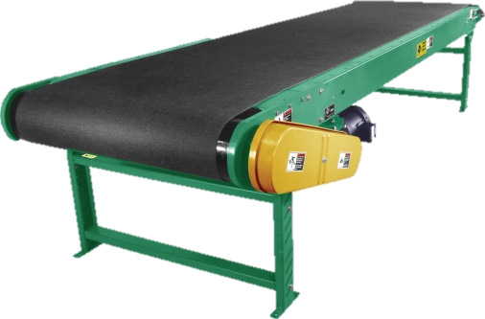
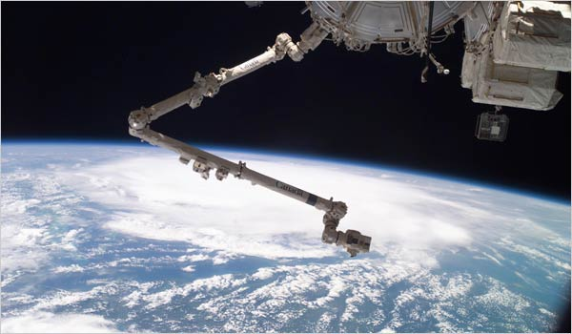
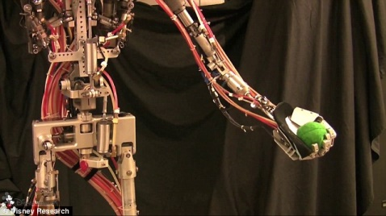
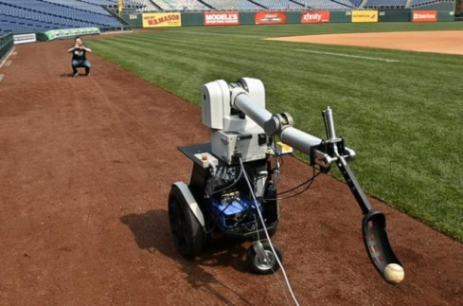
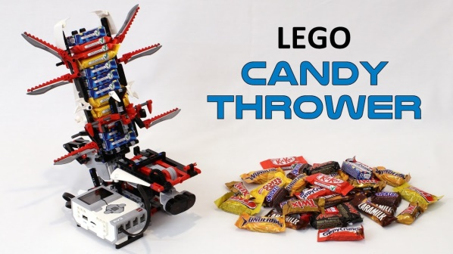
Background
What are they?
Machines which automatically grasp or intercept a target moving object
How could they be useful
Toys
Sports training
Robotic assistants on space walks
Impromptu conveyor systems over uneven terrain

Slide 3
Body - Design
Cartesian frame design
Conceptually simple
Bungee cord
Non-linear elasticity
Variable tension control
Spool
Recycling 3D printer filament spools

Slide 4
Body - Motors
Motor name here (Gearbox solution)
High torque but very slow!
Designed a gearbox – hard to get right with 3D printing
Stepper motors
Great specs
Poor performance from original motor driver
Poor control & slippage issues with alternative driver
Dynamixels
Slower performance & daisy chain coms issues
Out of the box solution though
Multithreading / parallel communications

Slide 5
Body - Throwing
Motors can’t handle pullback torques!
Solution: clamps! (futurama clamp bot)
Slow motor can be used to pullback

Slide 6
Gripper and Cameras
Passive gripper – egg-drop inspired design
FEA used to tune the design
Active gripper – FESTO inspired design
Deformable – can grasp a variety of objects
Tried and tested
Eye-in-Hand solution
Cables already needed to actuate the gripper
Simplifies the control for quicker turn-around

Slide 7
Vision - Attempted
Attempted several “generic” solutions
Changing Histograms
Changing lighting conditions
Optical Flow
Lateral motion dominance and slow
Pyramidal Scaling
Lateral motion dominance and noisy
YOLO
Slow (15fps max!)

Slide 8
Vision - Solution
Settled on simplicity – colour thresholding
Insert steps here?
Result had inconsistencies
Kalman filtering to interpolate and smooth

Slide 9
Control
Kinematics
Cord length velocities are dependent on the gripper position
Considers tension separately
Processors
Teensy used for encoded motors & steppers
Laptop used for everything else

Slide 10
Control
Communications
ROS used to pass data between major code blocks and processors
Stepper motor libraries on Teensy
OpenCV links to camera
Stepper motor stress testing
Very important test – can it play Green Hill Zone?

Slide 11
Results
Demo Time
=D

Slide 12
Questions?

